Slide 1
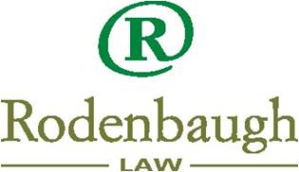
newTLDs: Implications for Trademark Owners Mike Rodenbaugh
Online Brand Management
in the World of New gTLDs
MelbourneIT Strategy Seminar
November 21, 2008

Slide 2
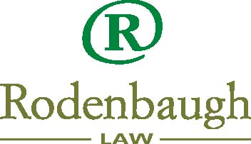
Mike Rodenbaugh
Formerly Yahoo!’s primary attorney in charge of trademark enforcement and defense.
In 2007, Mike started his own firm assisting IP owners with prosecution, enforcement, licensing and dispute resolution.
2
Notes:
2

Slide 3
IDNs and new TLDs are coming!
العربية 简体中文 繁體中文 Ελληνικά हिन्दी 日本語 한국어 فارسی Русский ייִדיש தமிழ்
.web, .blog, .sex … anywhere from 100 to 60 million other new TLD extensions
at least 20 new ‘geo-TLDs’ like .berlin, .nyc, .cym, .quebec, .gal, .paris, .eng, .africa, .lat

Slide 4
Recommendation 2 Strings must not be confusingly similar to an existing top-level domain or a Reserved Name.
Draft Implementation Guidelines:
A string that resembles another string is not necessarily confusingly similar (.ch, .cn, .cm, .om, .com all co-exist)
Initial Evaluation “to determine whether the applied-for gTLD string is so similar to one of the others that it would create a probability of detrimental user confusion”:
Algorithm provides “one objective measure” of confusingly similar
Panel of “String Similarity Examiners” will review – visual only? – and will create “contention sets that may be used later”
“no further reviews will be available”
If it passes Initial Evaluation, then formal objection may be filed by existing gTLD operator or by another applicant.
4

Slide 5
Recommendation 3 Strings must not infringe the existing legal rights of others that are recognized or enforceable under generally accepted and internationally recognized principles of law.
Legal Rights Objection available to any rightsholder
To be decided by WIPO dispute resolution procedure
One panelist; 60-90 day minimum timeframe
Fees paid at every step, refunded to prevailing party
“panel decision will be considered an expert determination, and will be considered by ICANN in making a final decision…”
5

Slide 6
IP Rights Protection Mechanisms
Cybersquatting and Phishing is too quick and easy, and remedies are too expensive and slow
ICANN Policy Development is needed to fix this
Potential options:
Standardized Sunrise Registration Process
Fast and cheap pre-UDRP process, with rapid DNS suspension upon default
Rapid DNS suspension upon evidence of phishing or malware (to be tested in dotAsia?)

Slide 7
newTLD Risks to TM Owners
Increased need for defensive registrations and/or anti-cybersquatting budget
Increased space for phishers and other criminal actors to exploit
Increased consumer confusion and reliance on search engines – Google gets bigger?!
Potential newTLD brand hijacking, and/or newTLD edge to your competition?

Slide 8
“.brand” Advantages
Security – you own and control the TLD, can register to anyone you choose
No domainers, squatters OR phishers?!
Marketing – create a global community centered on your branded TLD
Be one of the first in your industry
Develop new online products and promotions

Slide 9
“.brand” Risks
Switching from .com marketing and consumer mindset is sure to be expensive and lengthy
ICANN process
First-come, first-served with hefty application fee
Potential objections and increased cost
Operating a TLD
regular ICANN compliance reporting; policy work
legal exposure?
must use ICANN-accredited registrars?
ongoing cost to ICANN and to operational support

Slide 10
Help!!
Please join the Business Constituency!
1500 euro/year for large enterprises
500 euro/year for small enterprises
Active mailing list & regular teleconferences
Influencing ICANN policy development on behalf of all businesses
www.bizconst.org
mike@rodenbaugh.com

